Slide 1
CPU TECHNOLOGY
There are two types of CPU Technology.
RISC :- Reduced Instruction Set Computer
CISC :- Complex Instruction Set Computer

Slide 2
RISC CHARACTERISTICS
Few instructions
Few addressing modes
All Operations done in registers of CPU
Single Cycle instruction execution
Fixed length, easily decoded instruction format
Memory access limited to load & store instructions
Hardwired or Hardware based Control Unit

Slide 3
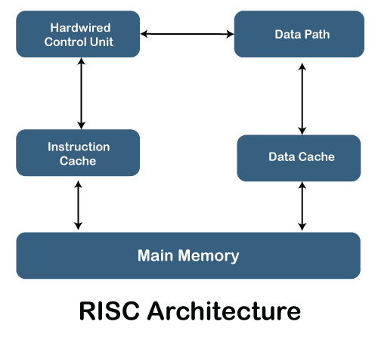

Slide 4
CISC CHARACTERISTICS
Large number of instructions
Large variety of addressing modes
Easy Compilation for high-level languages
Support the complex data structure
Variable length instruction format
Micro programmed Control Unit

Slide 5
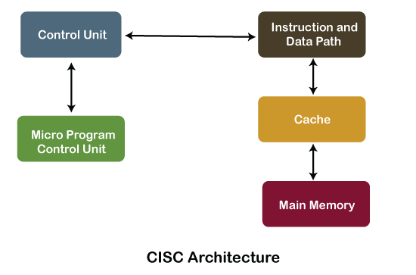

Slide 6
RISC v/s CISC
Key points RISC CISC
Speed faster slower
Expensive less expensive more expensive
Control Unit Hardwired Micro-programmed
No. of instructions 100-150 200-250
Example ARM, SPARK AMD, Intel
Note :- Other differences can be obtained by comparing the
characteristics.

